Slide 1


NEONATAL HEALTH MONITORING SYSTEM
Your Name
A Data Consultancy Framework for Digital Health Innovation
Kayitare Adolphe Cyusa,
December 10th, 2025

Slide 2

Track your neonates’ health from Day 1 to Day 30.
“

Slide 3
Target Audience
Ministry of Health
Clinicians and Healthcare Providers
Health- Tech companies
International development agencies

Slide 4
The Problem And Our focus
Neonatal mortality remains a critical global health challenge, with approximately 2.5 million deaths occurring in the first month of life annually with a high concentration in Low and middle income countries with sub-Saharan Africa and Southern Asia accounting for 80% of these deaths((World Health Organisation, 2024)
Early warning signs often missed due to fragmented systems.
Need for tools that support improved data and visibility, clinical reasoning and timely intervention(Rosa-Mangeret et al.,2022).

Slide 5
Data Source & Strengths
Dataset sourced from Kaggle’s Newborn Health Monitoring Dataset.
Includes vitals, feeding, stooling, weight, immunization
Benchmarked against WHO and AAP guidelines
Supports trend analysis and clinical dashboards
High completeness; cleaned with Tableau Prep and Excel

Slide 6
Data Preparation
Large newborn dataset for 100 babies (3000 rows and 22 columns) with unique IDs and variables across demographics, monitoring, feeding, hydration, and risk classification.
Column selection: Removed non-essential variables to streamline analysis. Extracted key categorical variables.
Key Variables: Focused on newborn age (days) and daily vital signs (temperature, heart rate, respiration rate, oxygen saturation).
Aggregation: Used Tableau Prep to average numeric variables per baby ID to support growth-comparison analysis.

Slide 7
Database design
Primary Key
Composite Key
Foreign Key
Ensures no duplication
Ensures that each row is uniquely traced
Links the data to its parent table’s primary key
Ensures if child data cannot exist without parent data
Connects more than one primary keys and maintains a structured record
baby_id, uniquely identifies each baby
(Size): Weight, length and head circumference- Unique for that baby of the particular age day.
(Vitals): Temperature_c, heart_rate_bpm) of one baby_id must match with the same baby_id in the parent table.
Notes:
Composite Key Example: In Excretion Table, urine + stool counts to that baby on that specific day.
Foreign Key: Ensures that the component data cannot exist without parent data

Slide 8
Database design
1 NF
3 NF
Size table is kept in separate attributes:
weight_kg, length_cm, head_circum_cm.
When normalized, the immunization table points to a lookup table. Immunization_id, where:
1= Immunized 2= Not immunized
Immunization table, Imunization_id and baby_id collectively provide specific status instead of writing text labels each time.
One to one and One to Many relationships are used.
One record in a parent table is connected with other records in neonates tables.
One baby is connected to many health records on a daily basis.
(Day 1 to Day 30)
2 NF
temperature_c provides meaning when it is connected to baby_id and age_days.
Notes:
Defining EER is required before performing queries, analysis and data visualization.

Slide 9
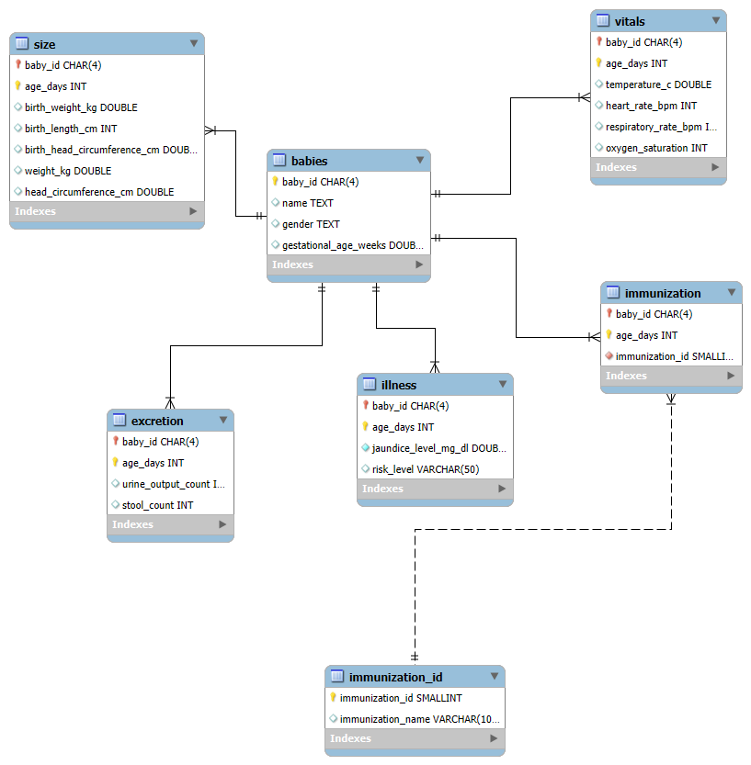
Database Design
EER Diagram

Slide 10
Data visualization
A newborn clinical dashboard:
Brings together real-time data on newborn health such as:
vital signs
birth outcomes
neonatal risk factors
care quality indicators into one easy-to-view platform

Slide 11
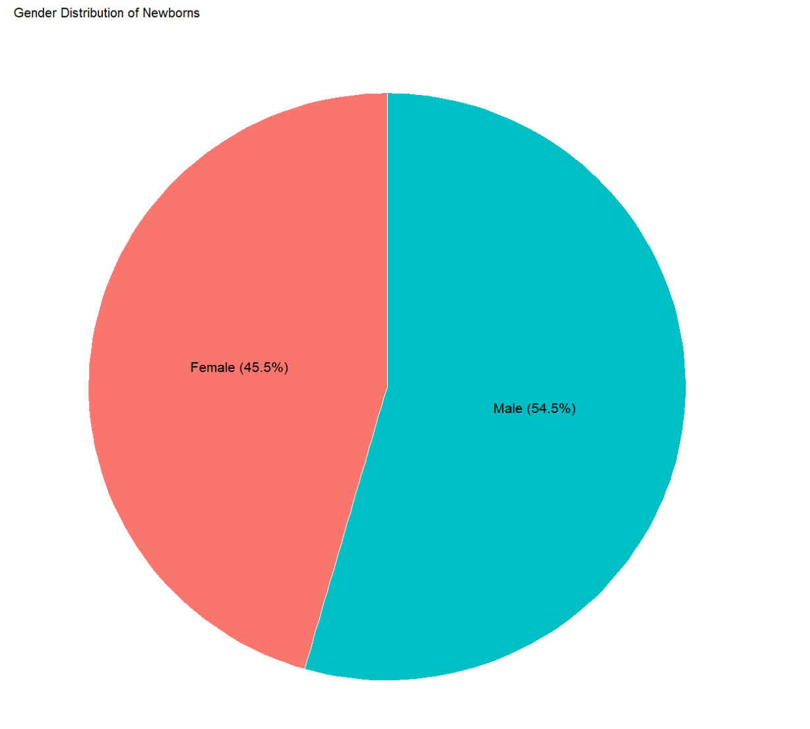
Gender Distribution
Shows the proportion of male and female newborns
Visualizes gender balance in the dataset
providing a quick overview of demographic distribution.

Slide 12
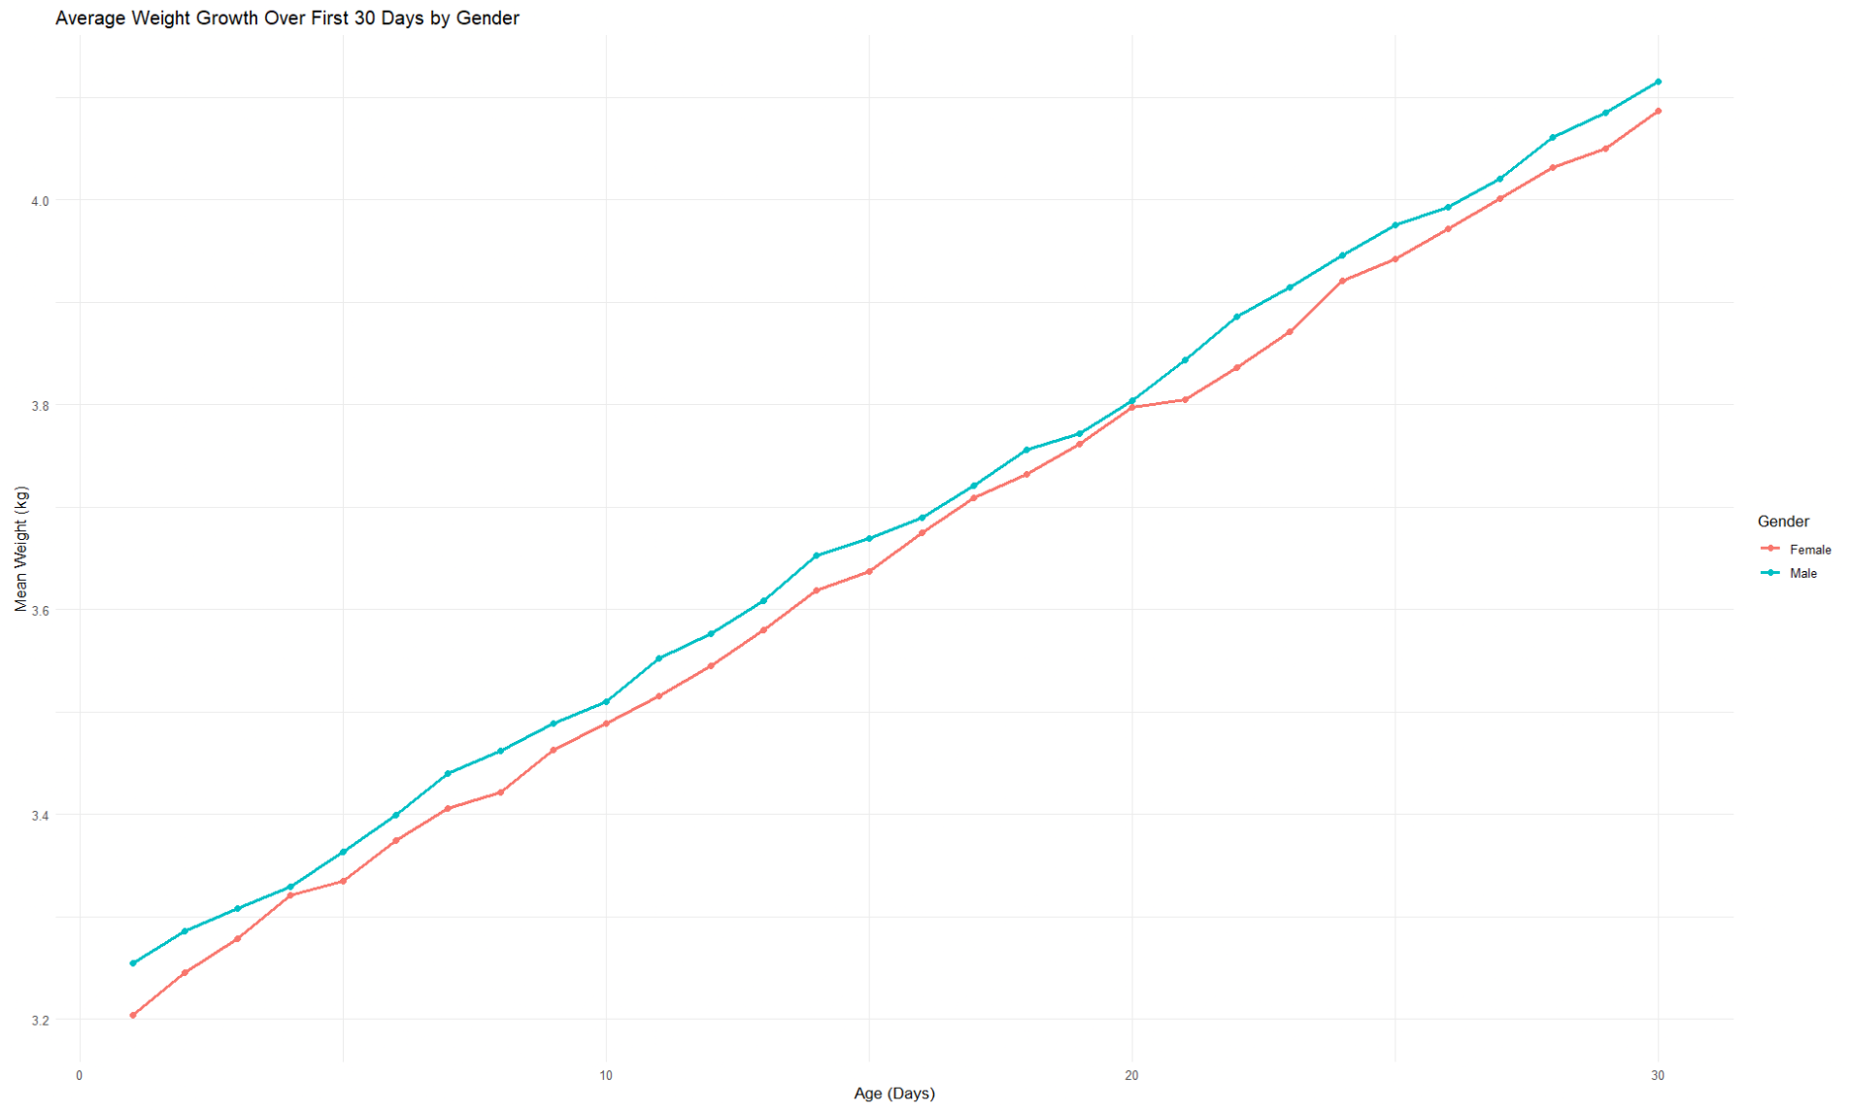
Daily Weight Gain trend
It helps to identify normal growth patterns and detect babies who are growing slower or faster than expected.

Slide 13
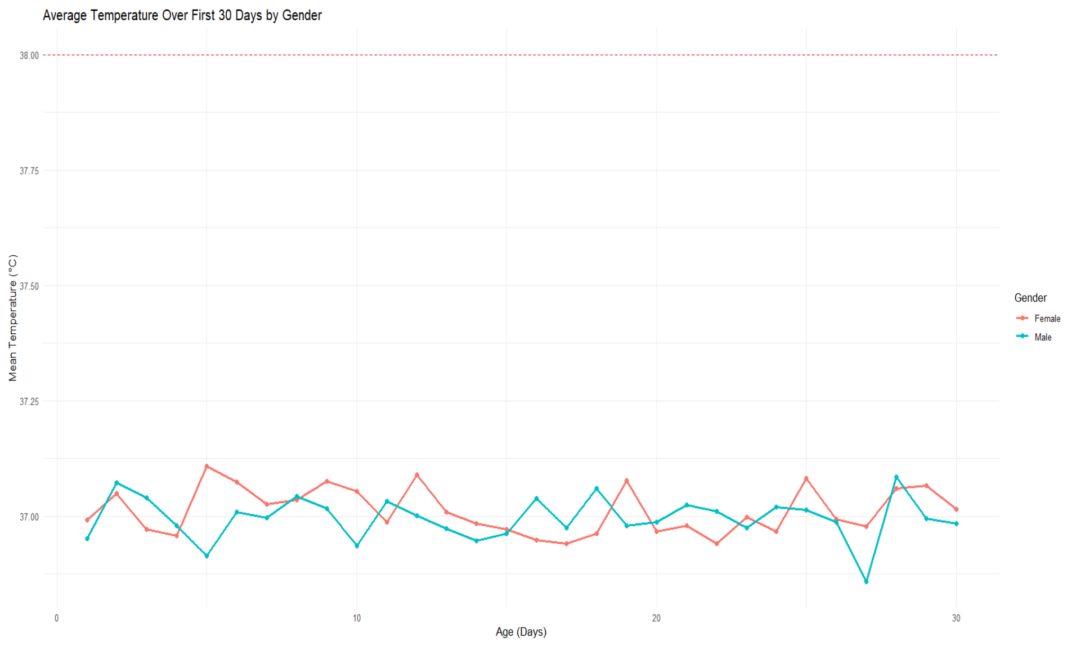
Temperature Trend Tool
Shows average body temperature changes over the first 30 days.
Helps to detect unusual temperature patterns that might indicate early infection.

Slide 14
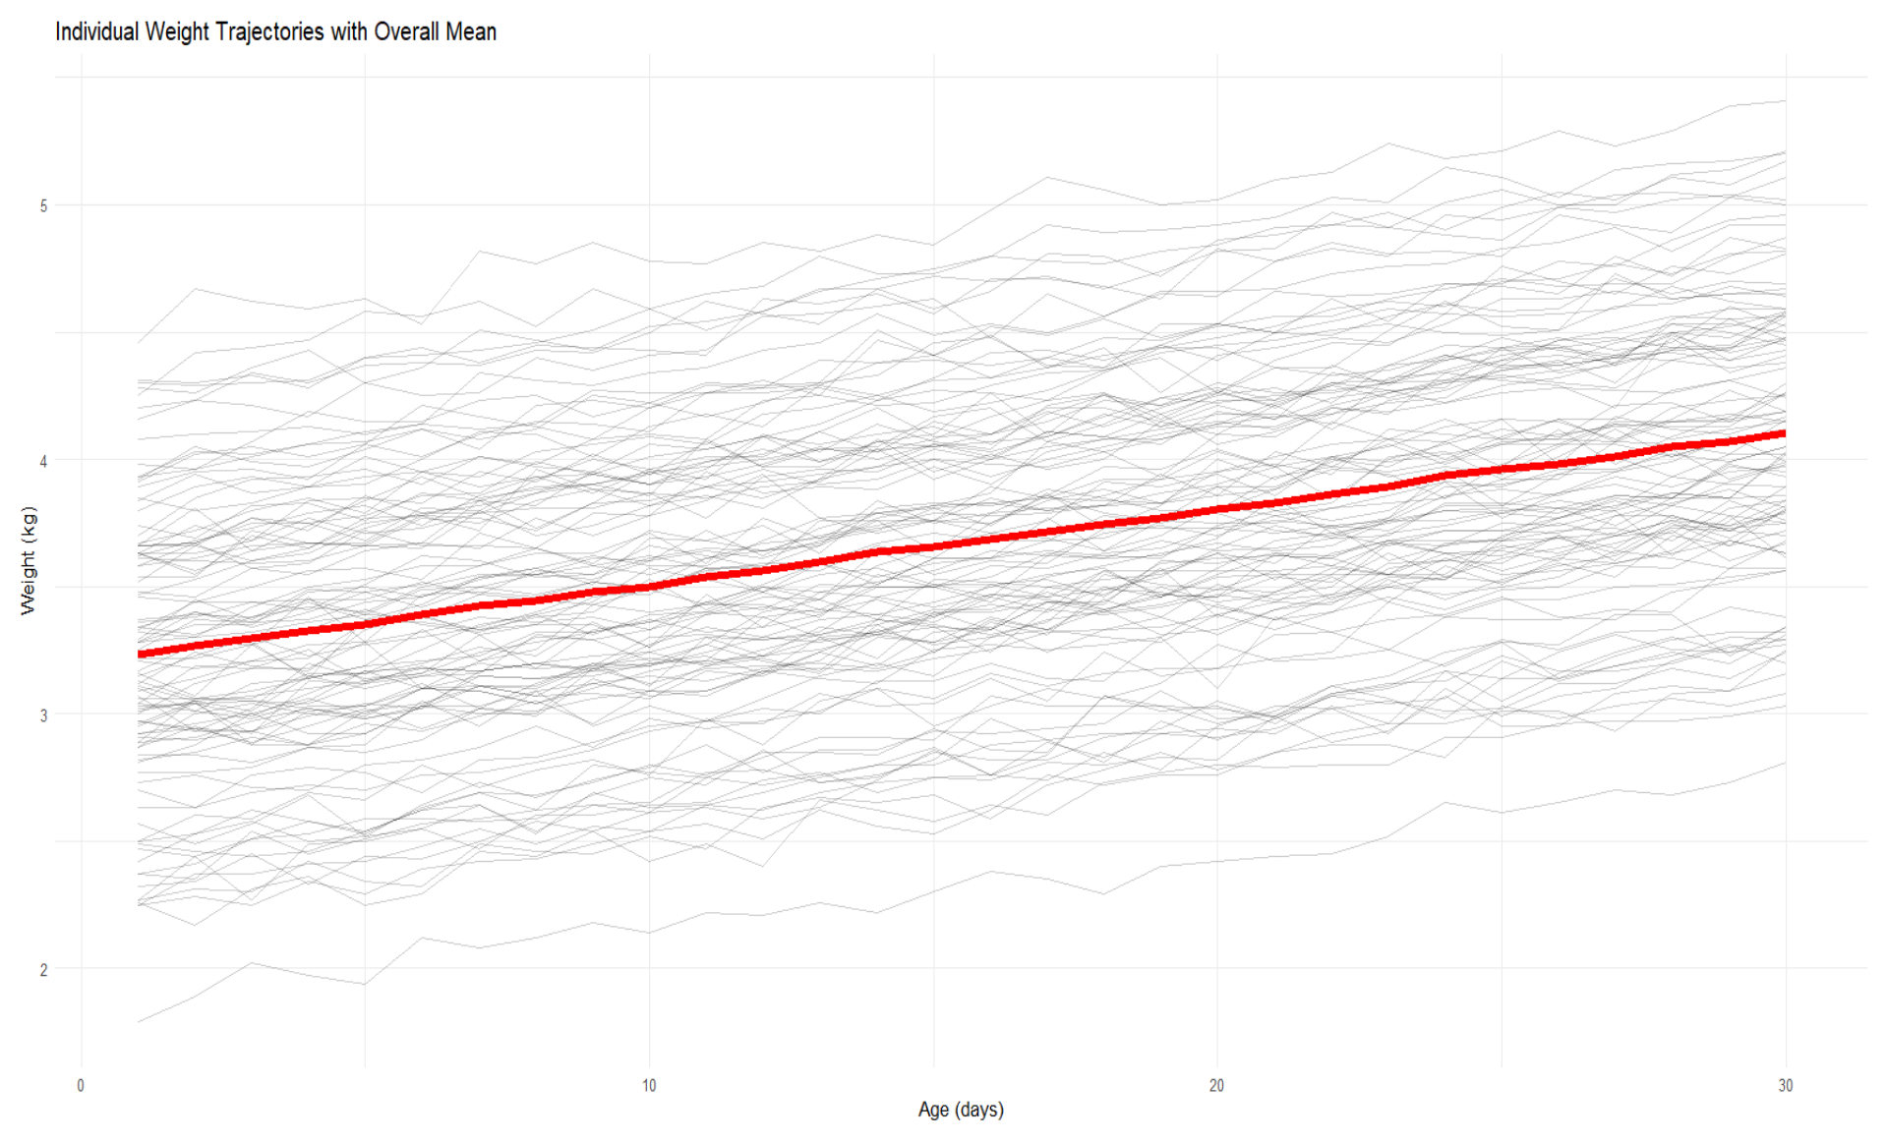
Weight Growth Spaghetti Plot
Each line represents an individual baby’s weight trajectory over 30 days.
The red line shows the
overall average trend, helping to compare individual growth of the baby to the population mean.

Slide 15
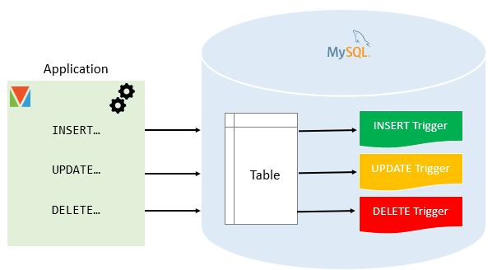
Trigger Details
Notes:
We implemented a set of MySQL triggers to strengthen data integrity and accountability within the newborn records system. Every time a baby’s information is inserted, updated, or deleted, our triggers automatically record the action in a separate audit table called stored_trigger. This table stores the baby ID, name, gender, the type of operation performed, and the exact timestamp of the change. By using NEW and OLD values inside the triggers, we ensure that both new entries and previous values are captured accurately. With this approach, we created a complete audit trail, allowing us—and future healthcare administrators—to monitor all modifications to the newborn data. This improves transparency, reduces the risk of accidental data loss, and ensures that the system maintains a reliable history of all database activity.

Slide 16
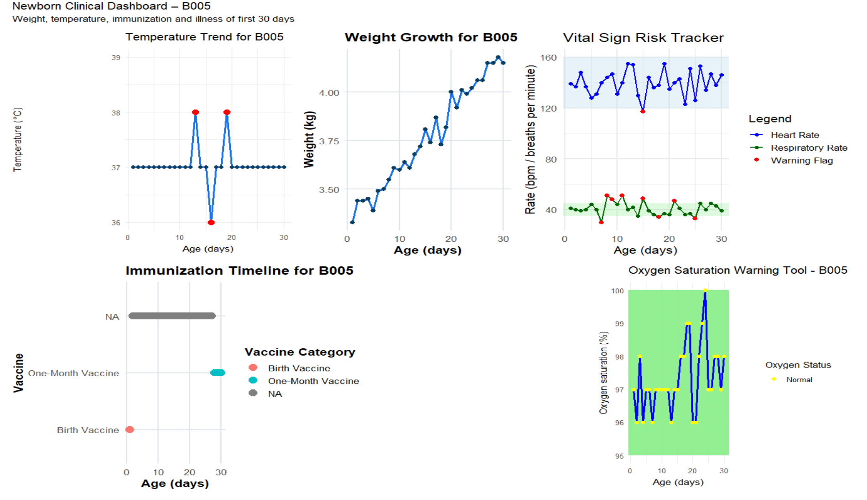

Slide 17
Business propositions
Enables early warning for neonatal sepsis and growth filtering
Supports Ministry of Health digital transformation goals
Reduces manual workload for clinicians
Provides real‑time dashboards for decision‑making

Slide 18
Opportunities for enhancement
Privacy & Data Security
Sensitive neonatal health data requires strict protection
Need for encryption, secure storage, and clear governance
Financial & Scalability Constraints
Ongoing costs for maintenance, servers, updates, and staff
Technical & Infrastructure Barriers
Limited internet, unreliable power, or few digital devices
Difficulty syncing data in rural or low-resource settings
Clinician Adoption & Workflow Changes
Need for training and ongoing support
Resistance if the tool adds steps or disrupts workflow
Deploy mobile alerts for clinicians

Slide 19
Summary
Normal growth patterns were identified.
Outlier babies can be detectable early.
Detected temperature deviations can predict the early infection risk.
The whole data monitoring system supports proactive clinical intervention.

Slide 20
Reference
World Health Organisation (2024). Newborn mortality. Retrieved December 3, 2025, from https://www.who.int/news-room/fact-sheets/detail/newborns-reducing-mortality
Rosa-Mangeret, F., Benski, A. C., Golaz, A., Zala, P. Z., Kyokan, M., Wagner, N., Muhe, L. M., & Pfister, R. E. (2022). 2.5 Million Annual Deaths-Are Neonates in Low- and Middle-Income Countries Too Small to Be Seen? A Bottom-Up Overview on Neonatal Morbi-Mortality. Tropical medicine and infectious disease, 7(5), 64. https://doi.org/10.3390/tropicalmed7050064
https://www.kaggle.com/datasets/miadul/newborn-health-monitoring-dataset

Slide 21



